Slide 1
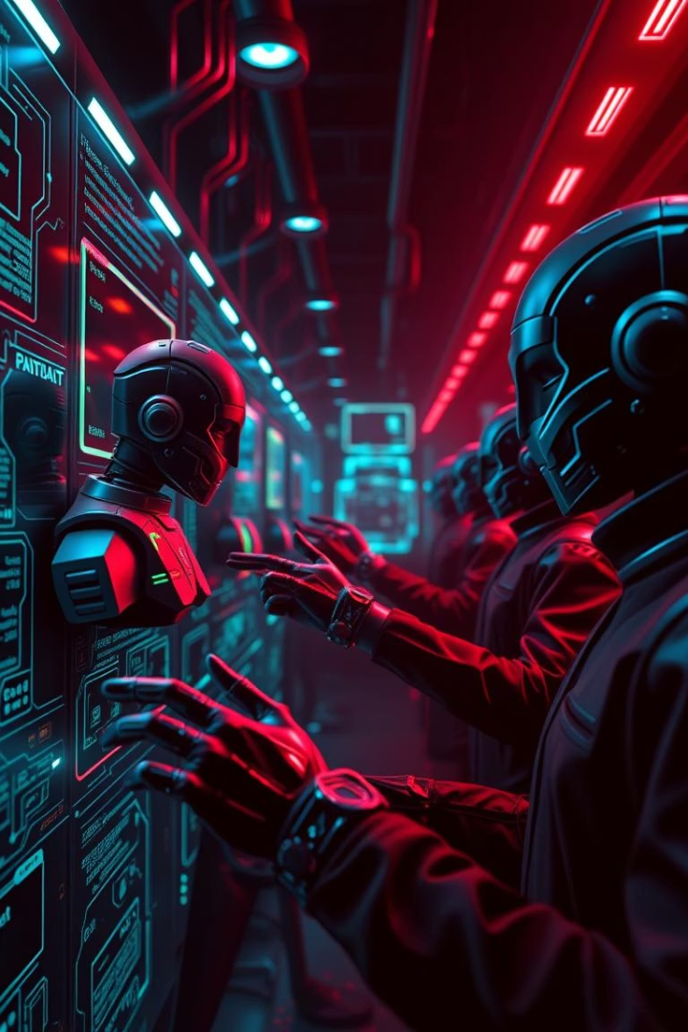
AI-Driven Cybersecurity: Multi-Agent AI for Coordinated Cyber Offense and Defense
AI-driven cybersecurity leverages artificial intelligence and machine learning to enhance defense capabilities beyond traditional rule-based systems. It addresses the exponential growth and sophistication of cyberattacks by enabling real-time analysis and proactive threat mitigation.
Multi-agent systems consist of autonomous agents working together to solve complex problems. In cybersecurity, these agents coordinate offense and defense to improve security posture efficiently and adaptively.

Slide 2

The Problem: Rising Cyber Threat Complexity
Complex Attacks
Limitations of Rule-Based Systems
Advanced Persistent Threats, zero-day exploits, and polymorphic malware evade traditional detection methods.
Static defenses struggle with novel attacks, require constant updates, and respond slowly, leaving vulnerabilities exposed.
Need for Adaptive Defense
Proactive threat hunting, automated rapid responses, and coordinated actions are essential for modern cybersecurity.

Slide 3

Solution: Multi-Agent AI System Overview
Collaborative Agents
Shared Intelligence
Proactive Security
Real-time threat intelligence sharing enables unified defense and coordinated offensive tactics like deception.
Continuous monitoring and automated actions improve overall security posture and incident containment.
Intelligent agents with specialized roles monitor, detect, and respond autonomously to threats.

Slide 4

Architecture & Core Agent Roles
Defensive Agent
Offensive Agent
Threat Analysis Agent
Coordinator Agent
Modifies firewall settings, monitors user activities, and automates patch management to block threats instantly.
Implements honeypots and deception technologies, proactively scans networks, and simulates attacks for training purposes.
Collects logs, applies AI and machine learning for anomaly detection, and produces actionable threat intelligence.
Enforces security policies, orchestrates response efforts, and manages centralized oversight of the system.

Slide 5

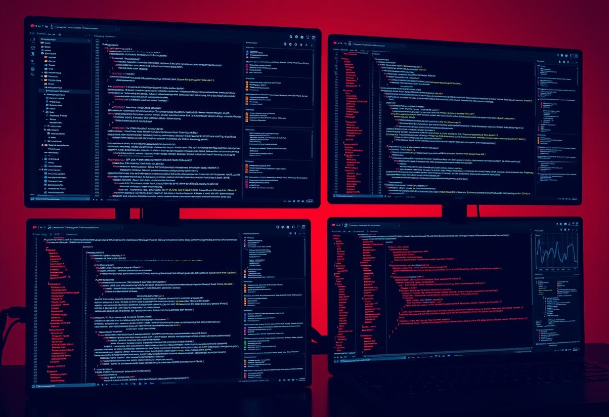
Code & Tools Behind the System
Frontend
Bootstrap, CSS, and JavaScript power the user interface and visualizations.
AI/ML Frameworks
Python with Scikit-learn, TensorFlow, and PyTorch for model development.
Backend
Flask and Node.js handle API and agent communication.
Visualization
Chart.js and D3.js create dashboards and reports for monitoring.

Slide 6
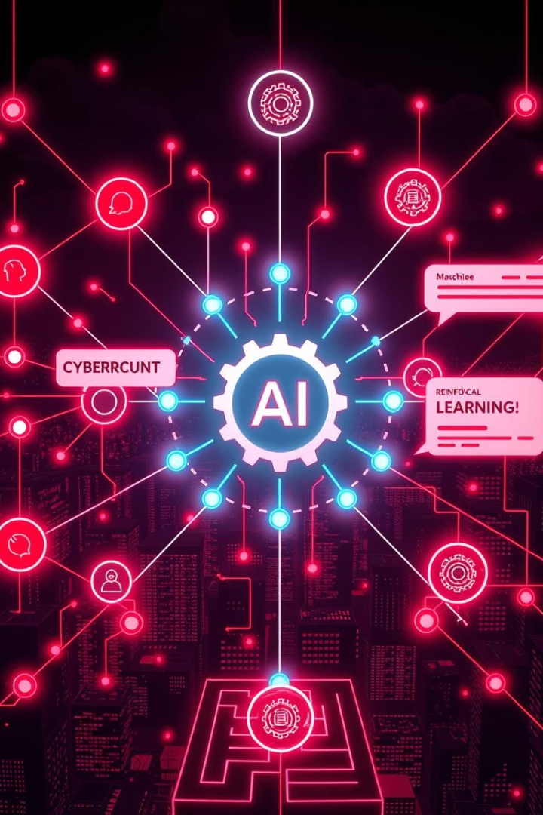
AI Capabilities for Cybersecurity
Machine Learning
Natural Language Processing
Reinforcement Learning
Detects anomalies in network traffic and user behavior using clustering, classification, and time-series analysis.
Enables agents to learn coordinated offense and defense strategies dynamically through trial and error.
Analyzes unstructured log data to identify threats faster through sentiment analysis and pattern recognition.

Slide 7


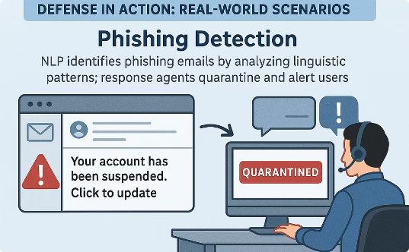
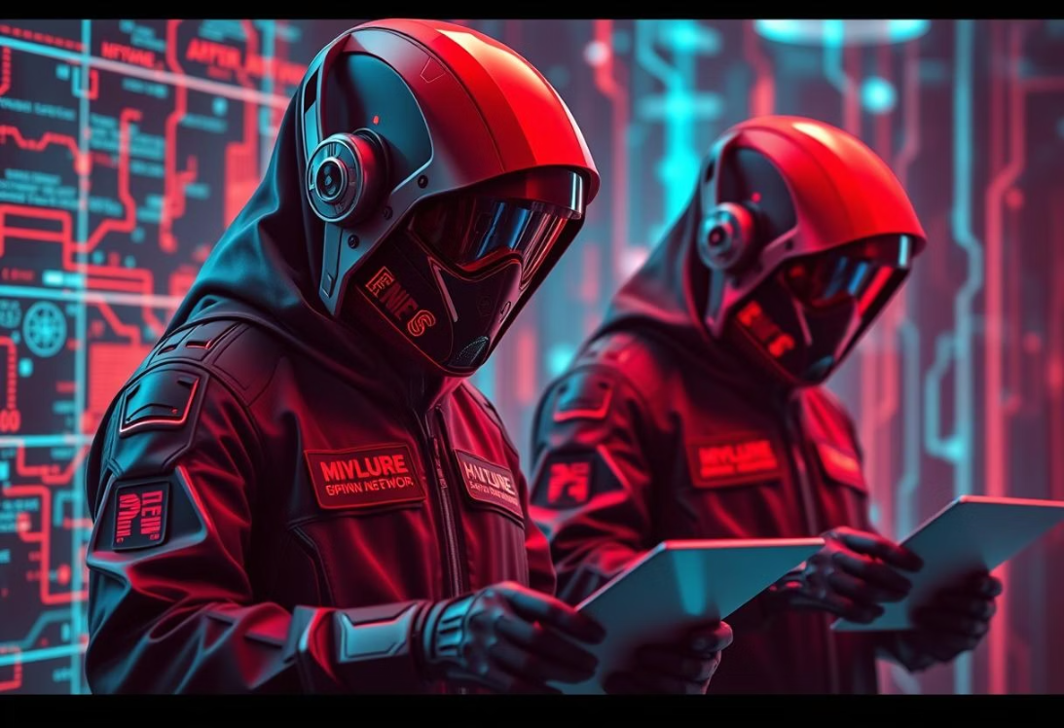
Defense in Action: Real-World Scenarios
Malware Detection & Isolation
Phishing Detection
Agents detect suspicious files, confirm threats, and isolate infected hosts to prevent spread.
NLP identifies phishing emails by analyzing linguistic patterns; response agents quarantine and alert users.

Slide 8


Coordinated Offense: Proactive Defense Tactics
Honeypot & Fake Data
Decoy Network Nodes
Offensive agents deploy decoy servers with fake data to trap and analyze attackers safely.
Decoy nodes mimic real services to detect external scans; response agents feed false info or block access.

Slide 9
Real-World Use Cases & Future Enhancements
Use Cases
Future Enhancements
Cyber warfare simulation training with adaptive red and blue agents.
Blockchain for tamper-proof agent communication.
Swarm intelligence for decentralized agent collaboration.
Enterprise endpoint defense with local and coordinated threat response.
Auto-adaptive learning loops for continuous AI retraining.
Critical infrastructure monitoring for early anomaly detection.

Slide 10
Performance, Deployment & Conclusion
Performance Metrics
Deployment Strategy
Improved accuracy over traditional systems.
Containerization with Docker for portability and scaling.
Reduced detection and response latency.
Web dashboard for real-time monitoring and analytics.
Low false positive rates maintained.
This multi-agent AI system offers adaptive, intelligent cybersecurity with proactive threat detection and automated coordinated offense and defense. For more details, access the full presentation on GitHub.
GitHub Presentation Link

